Slide 1
Knobbe Practice Webinar Series:
Strategic Considerations in Design Patent Filings in the United States
May 26, 2022
Mauricio Uribe
Vladmir Lozan

Slide 2
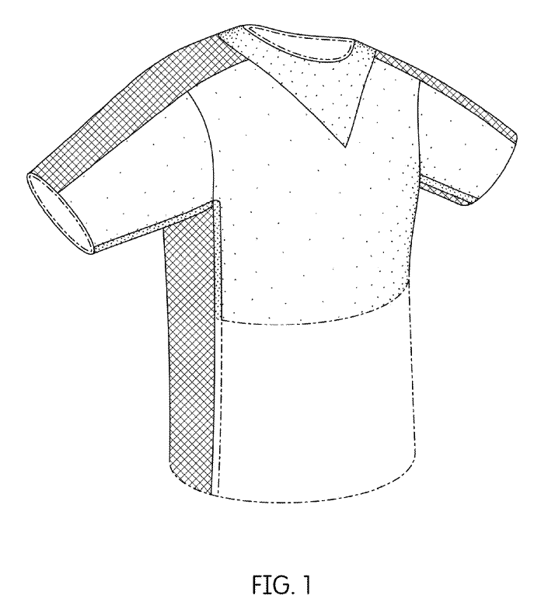
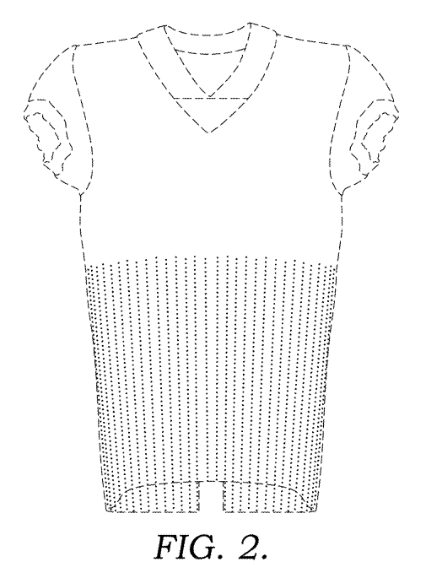
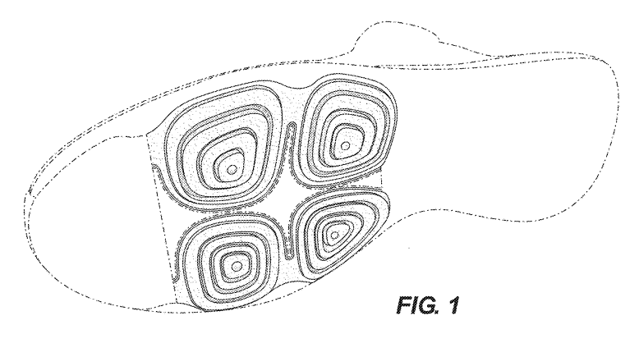
Design – Definition
A design consists of the visual ornamental characteristics:
  embodied in, or
  applied to
  an article of manufacture.
  configuration or shape of an article (or a portion of the article),
  surface ornamentation applied to an article, or
  the combination of configuration and surface ornamentation.

Slide 3
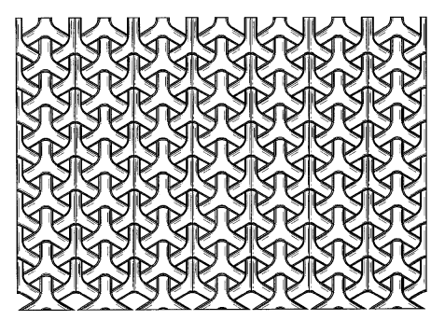
Design – Article of Manufacture
Must be embodied in an article of manufacture
  Can be a portion of an article
  Can be a material for surface ornamentation
  Can be a screen for GUI
No protection of a design in the abstract
  Curver Luxembourg (Fed. Cir. 2019)
    Title: Pattern for a Chair
    No chair shown, but court limited scope to a chair

Slide 4
Design – Specific Statutes and Rules
Statutes – 35 U.S.C. § 171-173
  Utility patent statutes generally apply
  6 month foreign priority
  15 year term from date of grant
Rules – 37 C.F.R. § 1.151-1.155
  Utility patent rules generally apply
  Sufficient number of views to completely disclose design
  Expedited Examination
    Pre-examination search & statement
    Fee

Slide 5
Design – Elements of the Application
Specification
Drawings
Specification
  Preamble
    name of the applicant
    title of the design
    brief description of the nature and intended use of the article in which the design is embodied
  Cross-reference to related applications (unless included in the application data sheet)
  Description of the drawing figure(s)
  Feature description (mirror image, broken line statement, etc.)
  A single claim

Slide 6
Design – Elements of the Application – Feature Description
Broken Line Statement –boundary, environment, or disclaimed subject matter
Mirror Image Statement – right side is mirror image of left side
Color – shading/stippling/fill represents contrast or specific color
Length Break – portions between break lines disclaimed
Creative use to support changes in future continuations
  Describe specific color options or combinations
  Describe what features or combination of features may be claimed or disclaimed
Consider including an Appendix of solid model renders or photographs for support purposes
  To support additional shading to clarify shape

Slide 7
Design – Elements of the Application – Feature Description
Examples
  “Applicant reserves the right to convert individual and various combinations of solid lines to broken lines in one or more continuation applications, since the figures convey that the inventors had possession of the features shown in solid lines, individually and in various combinations, as of the date of filing.”
  “Applicant reserves the right to convert the originally filed color figures to black and white line figures with appropriate shading and contour lines without the black and white line figures being considered new matter.”
  “The shading of the component represents a contrasting color between the shaded and unshaded portions. In the illustrated embodiments, the shading represents the color blue. The shading could represent red, green, or any other color. “

Slide 8
Design – Elements of the Application – Drawings
Line Drawings
Black and White Photographs
  If only practical medium to disclose subject matter
  limited to article – no background
Color
  Drawings or Photographs
  If necessary as only practical medium to disclose subject matter

Slide 9
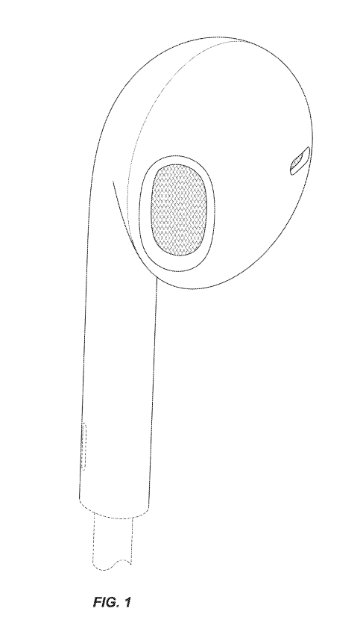
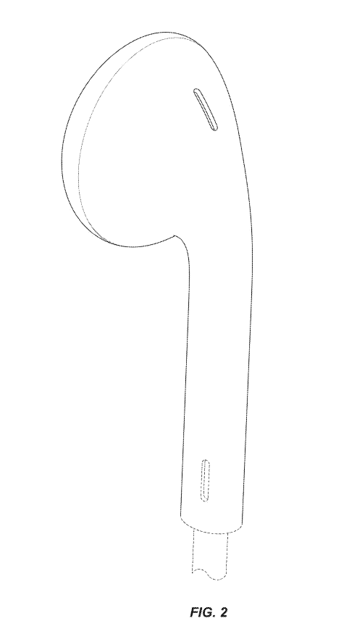
Design – Drawings – Number of Views
Sufficient number of views to completely disclose appearance of design
  At least One (1) Perspective View
  Two (2) perspective views can be helpful
    Can support changes to orthogonal views in case of inconsistency
  Usually Six (6) Orthogonal Views
Views not visible in use can be omitted
  Flat, unornamented bottom surface
Mirror image side view can be omitted

Slide 10
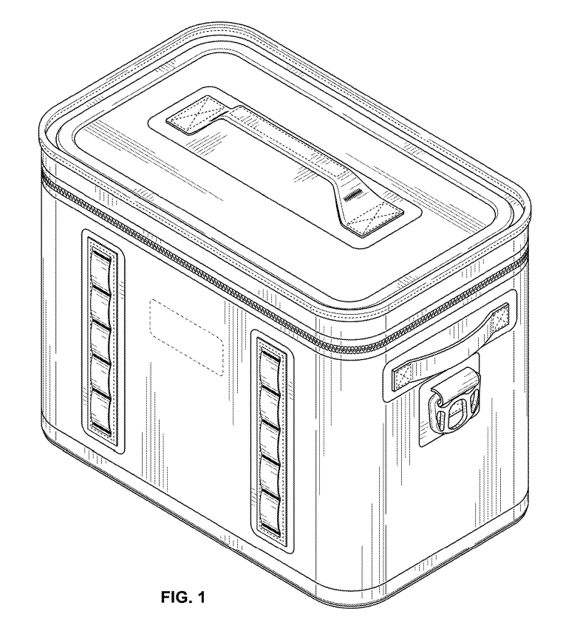
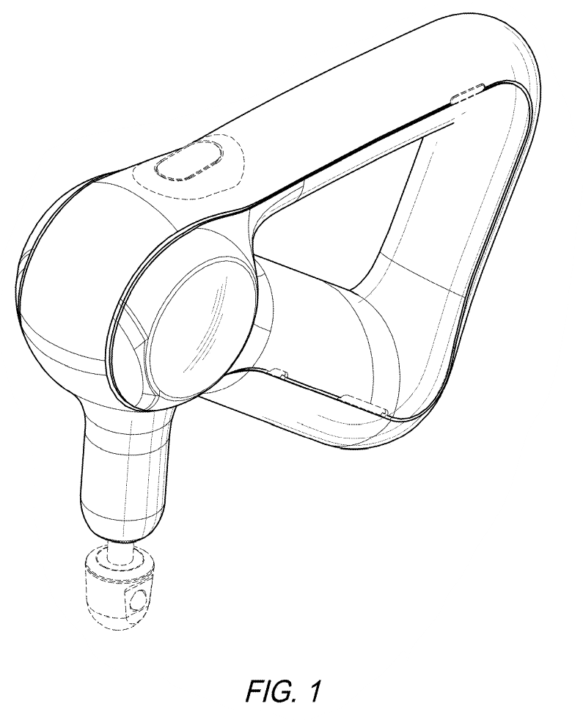
Design – Drawings – Shading or Contour Lines
To show contour of all surfaces of any three-dimensional aspects of the design
To distinguish between any open and solid areas of the design
To represent color or contrast
  Note: if the shape of the design is not evident from the disclosure as filed, addition of surface shading after filing may be viewed as new matter
  As noted previously, solid model renders or photographs can support addition of surface shading

Slide 11
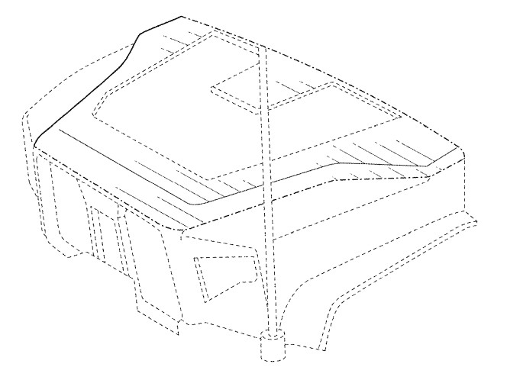
Design – Drawings – Broken Lines
Used to define scope
  Disclaim portion of article
  Designate boundary of claimed subject matter
    Usually dash-dot
Boundary Line
Disclaimed Subject Matter

Slide 12
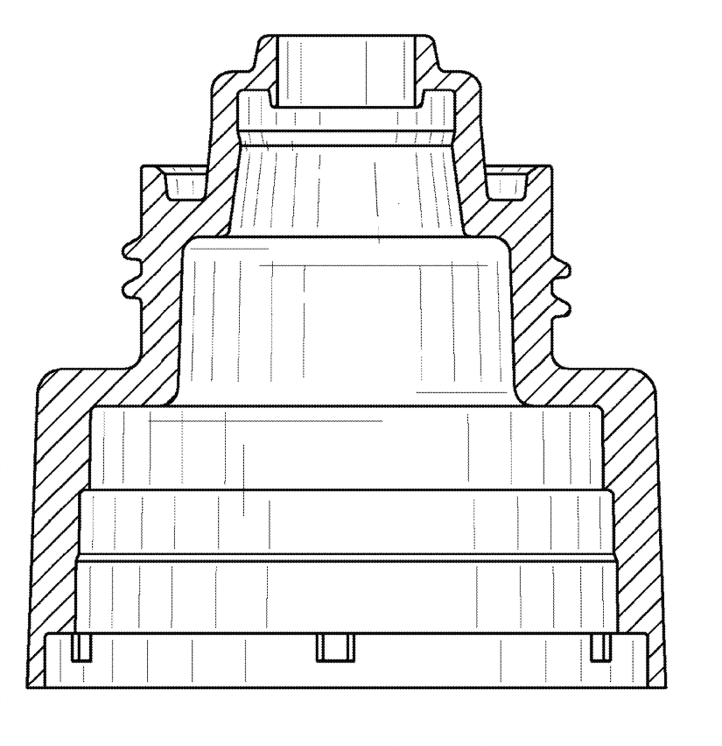
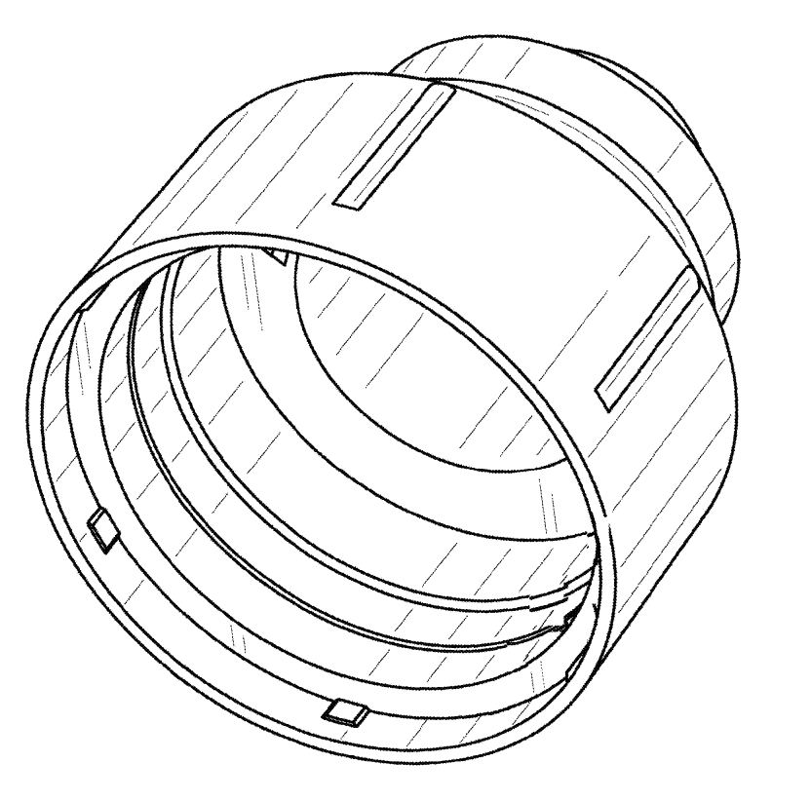
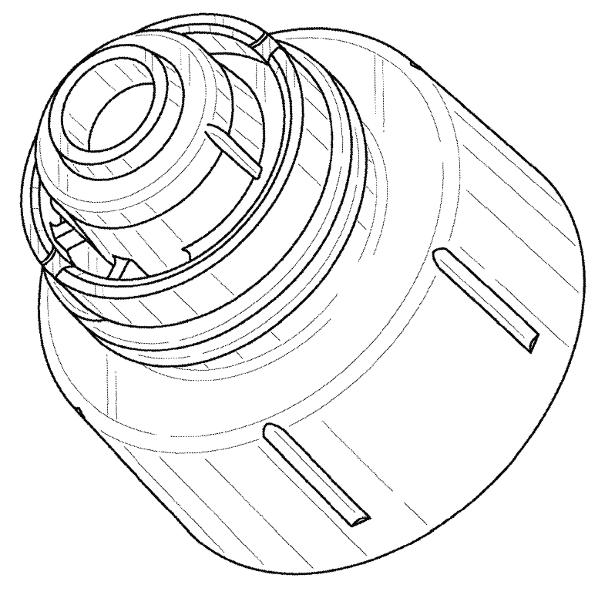
Design – Drawings – Sectional Views
Usually to disclose internal features
Clarifies shape of portion not visible in other views

Slide 13
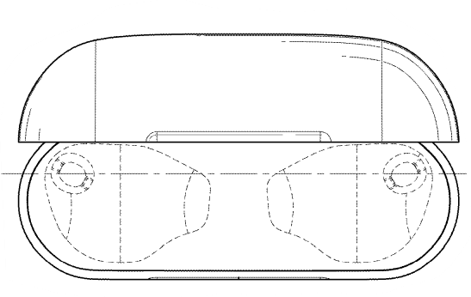
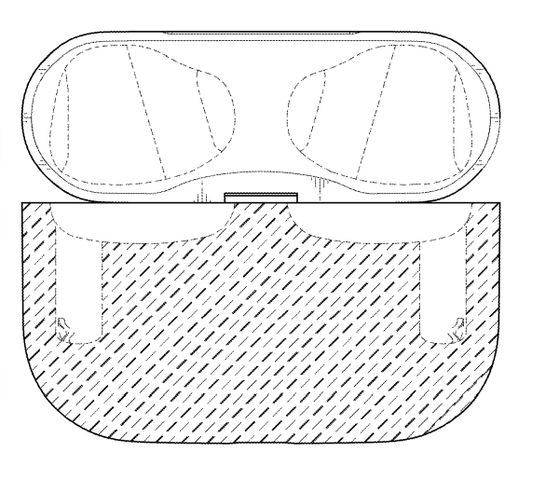
Design – Drawings – Internal Structures
Alternative to Cross-Section is to Disclaim Internal Structure
Disclaim internal portion not visible in regular views – if cross-section view is not provided

Slide 14
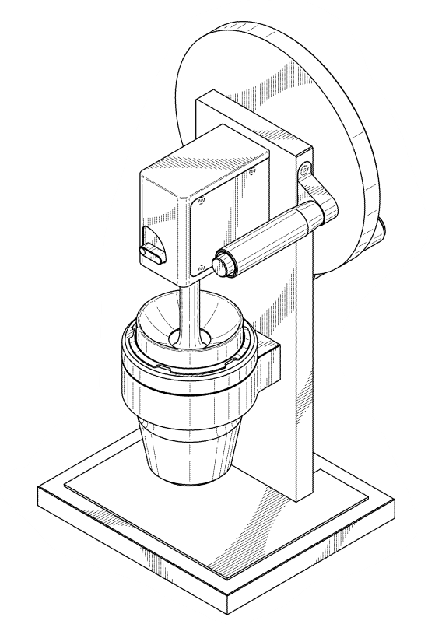
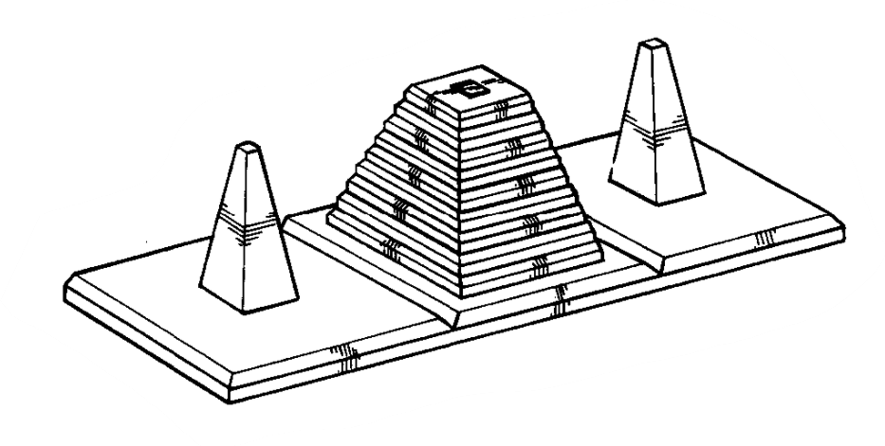
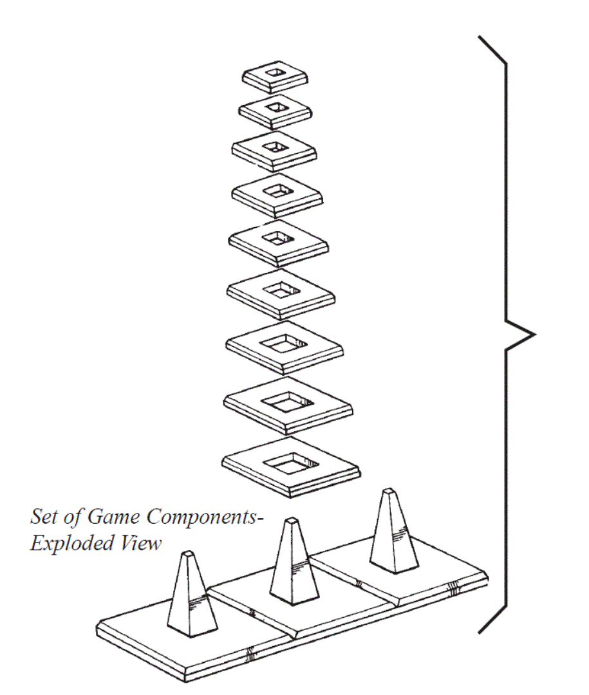
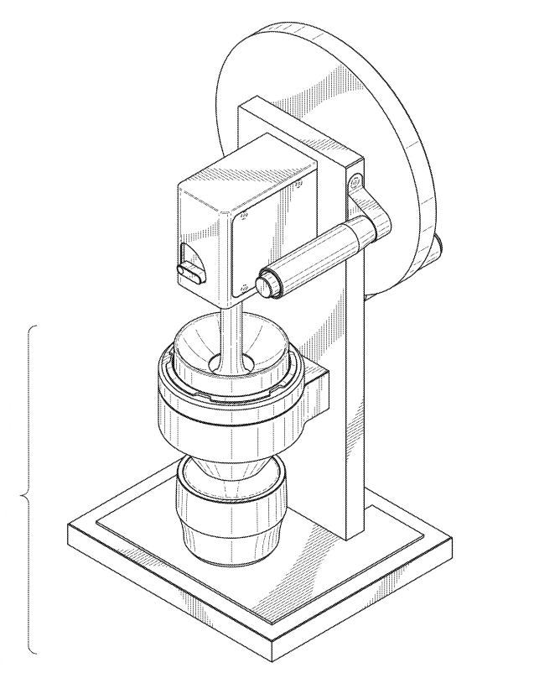
Design – Drawings – Exploded View
Bracket used to “connect” separate structures

Slide 15
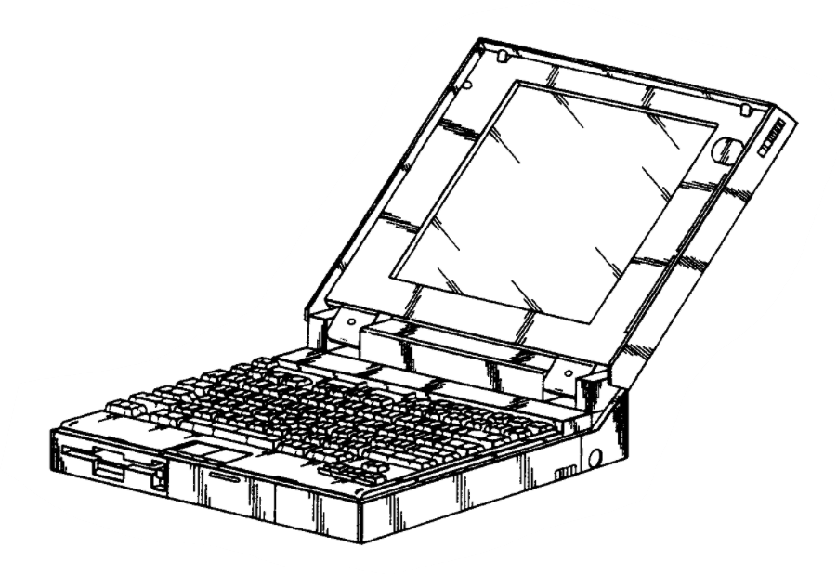
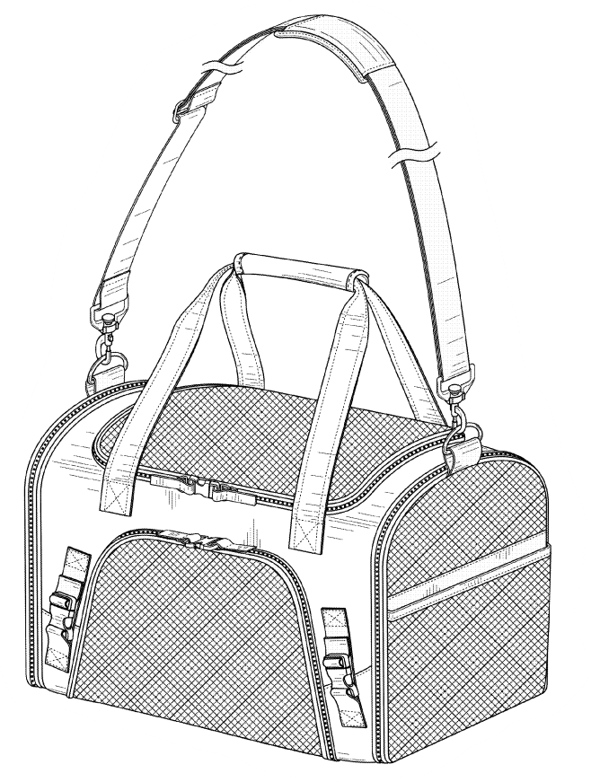
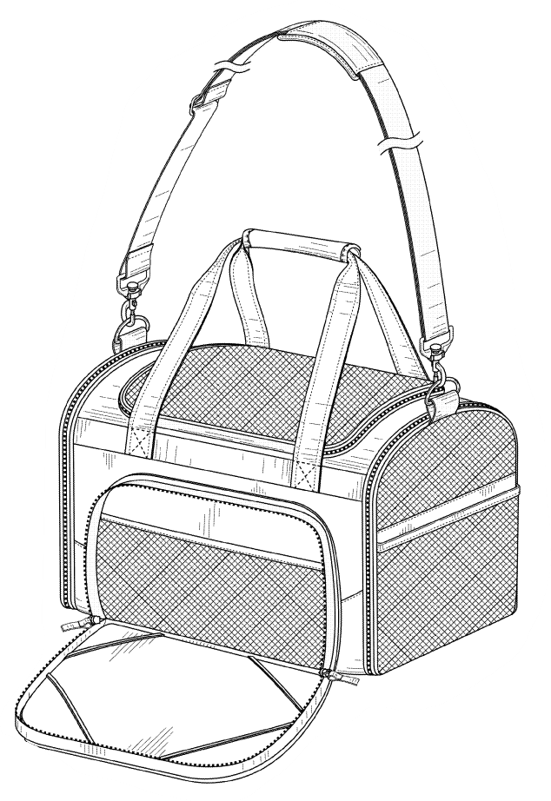
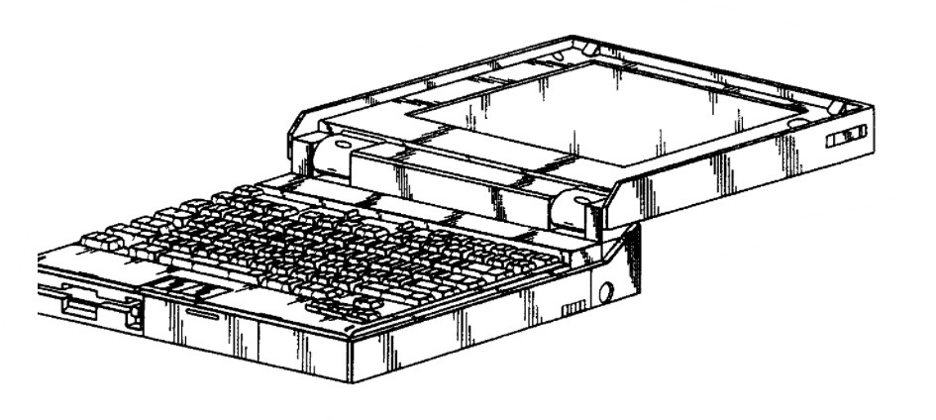
Design – Drawings – Alternative Positions
Shown in separate figures

Slide 16
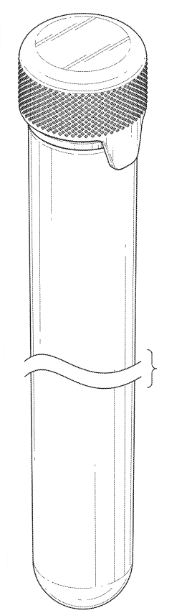
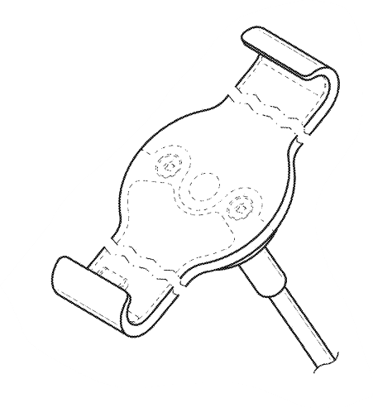
Design – Drawings – Length Break
To show indeterminate length

Slide 17
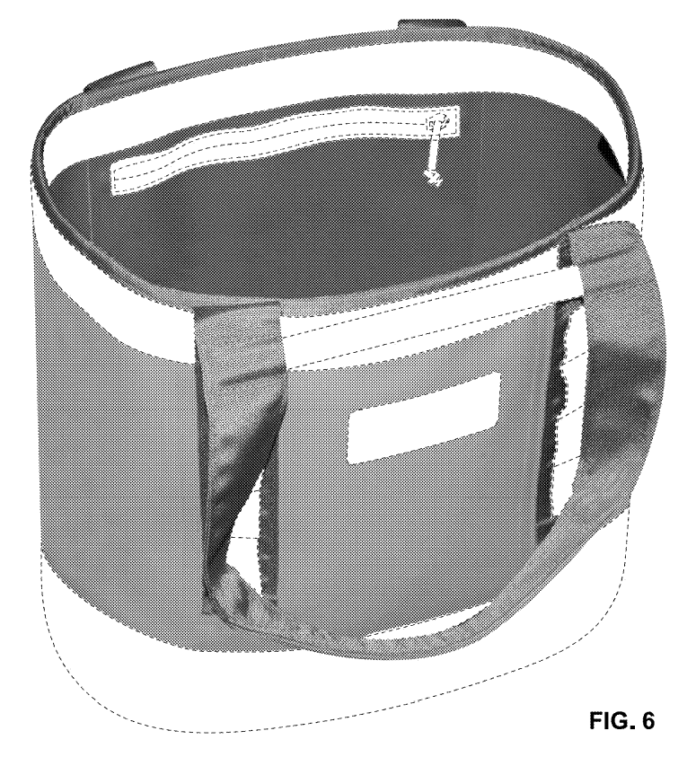
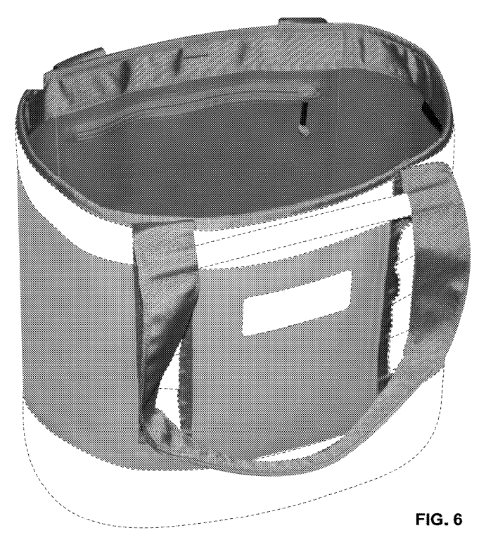
Design – Continuation Applications
Can be used to pursue broader/different scope.
Solid lines can generally be converted to broken line to disclaim originally-claimed subject matter.
Attempting to convert original broken line to solid line can be problematic (e.g., is shape of broken line structure clear without shading/contour lines?).

Slide 18
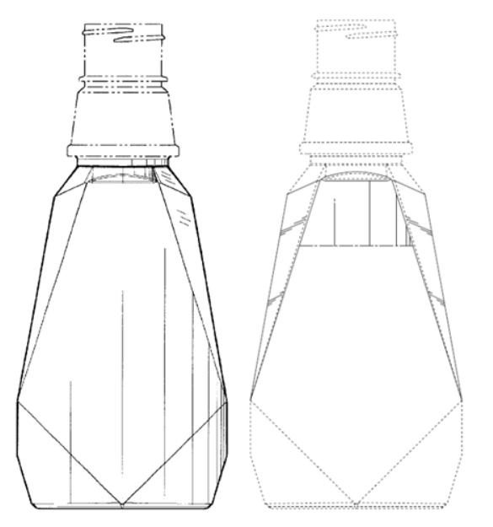
Design – Continuation Applications
Boundary lines must be supported by the original application
Existing boundary lines can be used
Boundary lines cannot be introduced
  Unless it is clear the boundary of the claimed design is a straight broken line connecting the ends of existing lines

Slide 19
Example Design Patents – User Interfaces
  Each embodiment is a “snapshot” of current state of UI
  Can be filed as screen capture or wireframe

Slide 20
Design Patent Examples – Icons and Typefaces
Type fonts can be protected
Typeface can be protected
Individual icons can be protected – multiple embodiments depending on the device

Slide 21
Priority Claim Scenarios for US Design Applications
International Design Application
6-month time limit
US Design Application
Priority Date
International Utility Application
6-month time limit
US Design Application
Priority Date
International Utility Application
6-month time limit
US Utility Application
US Design Application
Priority Date

Slide 22
Priority Claim Scenarios for US Design Applications
US Nonprovisional Utility
Application
US Design Application
No time limit as long filed as divisional application within pendency of utility application
Priority Date
International Utility Application
6-month time limit
US Utility Application
US Design Application
Priority Date

Slide 23
Priority Claim Scenarios for US Design Applications
International Utility Application
> 6-month time limit
US Design Application
Priority Date
International Utility Application
> 6-month time limit
US Utility Application
US Design Application
Priority Date
Disclosures/Filings made less than one year are not prior art.
No priority but filing will not bar design application

Slide 24
Thank you!
Mauricio.uribe@knobbe.com
Vladimir.lozan@knobbe.com

